Slide 1

Rotten Tomatoes Movies Analysis
Project Owner:- Ankit Raj Mishra

Slide 2
CONTENTS
Introduction
01
KPI/Objectives
02
Insights
03
Conclusion
04

Slide 3


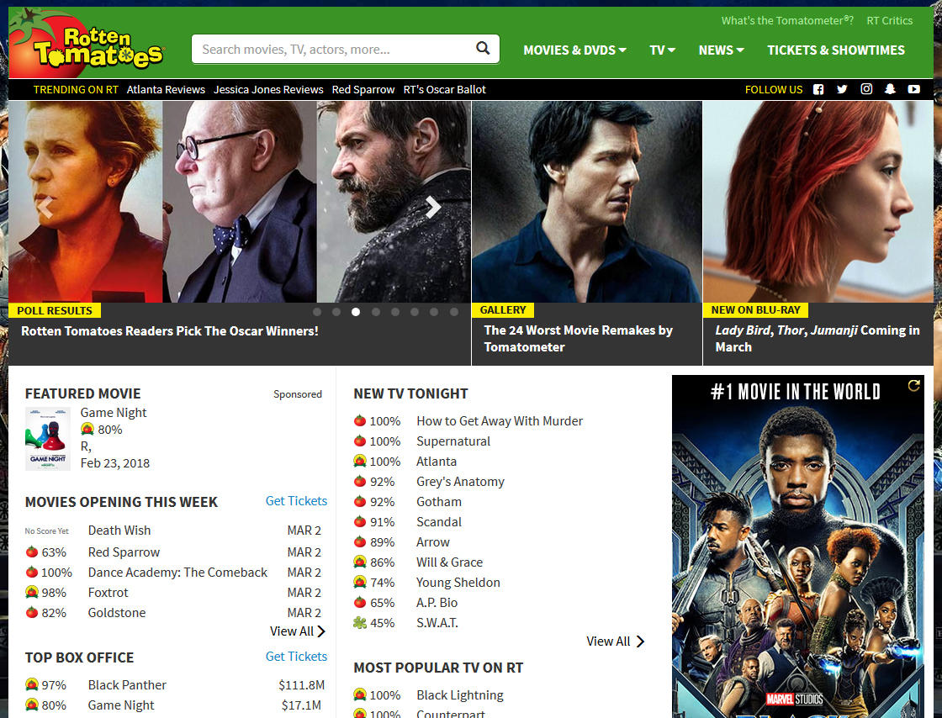
Introduction
01
While information on films may be found on many well-known websites, Rotten Tomatoes is the best source for critic reviews. This website enables users to compare the ratings offered by frequent users (audience score) and the scores provided by critics (Tomato-meter) who are officially accredited members of various literary guilds or film critic groups.

Slide 4

02
Objectives-KPI
What does the distribution of films look like by rating? My primary genre? (Hint: use the first genre listed)
What % of films received a Certified Fresh Tomato-meter rating? What about Rotten?
Explore new film releases over time. How has the volume of releases by month trended over time? What year/month were the newest films released?
Compare average Tomato-meter ratings by Studio. Which studios produce the highest-rated films, on average? The lowest?
Compare the Tomato-meter ratings against audience ratings. Which films showed the largest discrepancies between audiences and critics??
Explore the critic's consensus rating: what language is used most often?

Slide 5
Insights
03
What does the distribution of films look like by rating? My primary genre? (Hint: use the first genre listed)
Movies are released based on one of 6 rating categories: R, NR, PG-13, PG, G, and NC17. The movie's primary genre is comedy, followed by drama, action & adventure, and so forth.
R: -Restricted – Under 17 requires accompanying parent or adult guardian.
NR: - If a film has not been submitted for a rating or is an uncut version of a film that was submitted, the labels Not Rated (NR) or Unrated (UR) are often used.
PG13: - Parents strongly cautioned under age 13
PG: -Parental guidance suggested
G: - General audiences-All ages admitted
NC17: - No children under 17 admitted.

Slide 6
Insights
03
What % of films received a Certified Fresh Tomato-meter rating? What about Rotten?
17.77% of Movies received Certified Fresh, 38.75% received Fresh and 43.47% received Rotten Ratings.

Slide 7
Insights
03
Explore new film releases over time. How has the volume of releases by month trended over time? What year/month were the newest films released?
1319 Movies released per month every year.

Slide 8
Insights
03
Compare average Tomato-meter ratings by Studio. Which studios produce the highest-rated films, on average? The lowest?
Comparison is provided between Studio and Tomatomer Average Rating.
IFC Flims has produce highest Rated Films and Movie Count is 398 and lowest rated Studio are many which got 0 Rating from Tomatomer Criteria Ratings.

Slide 9
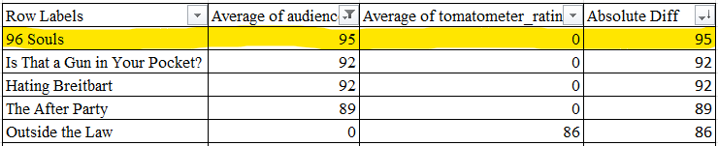
Insights
03
Compare the Tomato-meter ratings against audience ratings. Which films showed the largest discrepancies between audiences and critics
Comparison has provided between audience rating and Rotten Tomato-meter Rating.
The Movie 96 Souls has the highest discrepancies between audiences and critics that is 95

Slide 10
Insights
03
Explore the critic's consensus rating: what language is used most often?
76.10% of critics' overall assessments are positive, 14.26% are neutral, and 9.64% are negative.

Slide 11
Conclusion
04
Excel was utilised in the study to find patterns and trends in the data, including the comedy genre's highest rating count and differences between Tomato-meter and audience ratings for select films. The data also revealed the studios with the lowest and greatest ratings, providing studios with a benchmark against which to measure their success and raise their ratings. The analysis helps studios improve their performance and have more success in the film industry by offering insightful information about the elements that lead to high Tomato-meter scores for films with a "R" classification.

Slide 12




THANK YOU !
Do you have any questions?
https://www.linkedin.com/in/ankitrajmishra/
Lucifer2459
0111rajankt@gmail.com
https://peerlist.io/ankitrajmishra
Project Owner:- Ankit Raj Mishra

